Slide 1
MIS3690 Web Technologies
Babson College
TOIM Division
Fall 2015
MIS3690 Web Technologies Fall 2015
10/13/15
<number>
Notes:
<number>

Slide 2
Forms Server-side Processing
MIS3690 Web Technologies Fall 2015
10/13/15
<number>

Slide 3
Forms
Why forms?
Let visitors interact with your site
Change the nature of your site from a presentation or brochure oriented site to an interactive site
Collect important information
Form Functions
Input
Action
Usually taken by server, but can also be done on browser by JavaScript
Occurs when user clicks on "Submit" button
MIS3690 Web Technologies Fall 2015
10/13/15
<number>

Slide 4
Form Example
<form method="post" action=mailto:zli@babson.edu enctype="text/plain">
Form text and input tags go here
</form>
MIS3690 Web Technologies Fall 2015
10/13/15
<number>

Slide 5
Form Tag Attributes
action – identifies a server (URL) and the program to be run on it.
The only required attribute
Can also be mailto:address (only works if the user has a mail program such as Outlook installed. It will not work with webmail.)
method – describes how form’s data is sent to server (see next slide)
enctype – describes how the form input is encoded before being sent
MIS3690 Web Technologies Fall 2015
10/13/15
<number>

Slide 6
Form Methods
Post | Get*
Form data are encoded into a message sent to the server. | Form data is encoded by the browser into a URL.
Better functionality: Can retrieve, store, and update data, modify databases, etc. | Best used for retrieving data.
No restriction on amount or type of data sent | URL max length of 100 and ASCII characters only
More secure | Less secure
* Get is the default method if no method is specified.
MIS3690 Web Technologies Fall 2015
10/13/15
<number>

Slide 7
Form Input With <input> Tag
Text line: <input type="text" />
Password: <input type="password" />
Radio buttons: <input type="radio" />
Check boxes: <input type="checkbox" />
Files: <input type="file" />
Hidden data: <input type="hidden" />
HTML5 New Input Types:
http://www.w3schools.com/html/html_form_input_types.asp
MIS3690 Web Technologies Fall 2015
10/13/15
<number>

Slide 8
Input Tag Attributes
type – the type of input
name – names the input tag. Names and the user-entered data are passed as pairs to the server
Name is mandatory for each <input> tag
Other attributes depend on the type
MIS3690 Web Technologies Fall 2015
10/13/15
<number>

Slide 9
Input Tag Context
Input tags must be placed inside the <form> tags and if necessary, inside the same types of tags that text is placed:
<p> - use this to space elements evenly
<h#>– use this to format the text
where # is one of 1…6
<td> - when you need a form inside a table!
MIS3690 Web Technologies Fall 2015
10/13/15
<number>

Slide 10


Input: type = "text"
Example:
<p> Last Name
<input type= "text" name="lname" maxlength="100" size="20" value="Enter name here" /> </p>
password type works the same way, except that value appears asterisked out as it is entered
type= "password "
MIS3690 Web Technologies Fall 2015
10/13/15
<number>

Slide 11

Input: type = "radio"
Note: Same name implies that
only one of these radio buttons
can be true at a time.
Example:
<p>Gender:
Male <input type="radio" name="gender" value="male" />
Female <input type="radio" name="gender" value="female" checked="checked" /></p>
Note: optional checked attribute indicates if one of the buttons should be checked initially.
MIS3690 Web Technologies Fall 2015
10/13/15
<number>

Slide 12
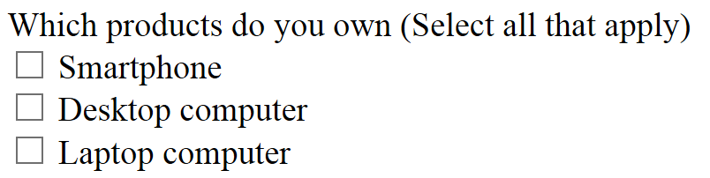
Input: type = "checkbox"
Example:
<p>Which products do you own (Select all that apply)<br />
<input type="checkbox" name="Q1" value="Smartphone" /> Smartphone<br />
<input type="checkbox" name="Q1" value="DeskC" /> Desktop computer<br />
<input type="checkbox" name="Q1" value="LapC" /> Laptop computer</p>
Optional attribute: checked="checked"
MIS3690 Web Technologies Fall 2015
10/13/15
<number>

Slide 13
Input: type = "hidden"
A hidden field is one that is not visible to the user, however it can be seen when viewing the source code.
Why use hidden fields:
Server-side program can collect data from one form to another
This makes it easier for the users.
Example:
<input type="hidden" name="name" value="value"/>
MIS3690 Web Technologies Fall 2015
10/13/15
<number>

Slide 14

Buttons With Input Tag
Example:
<input type="submit" value="Submit" name="Submit" />
<input type="reset" value="Reset" name="Reset" />
These two are standard buttons. The "type" value should not be changed!
MIS3690 Web Technologies Fall 2015
10/13/15
<number>

Slide 15
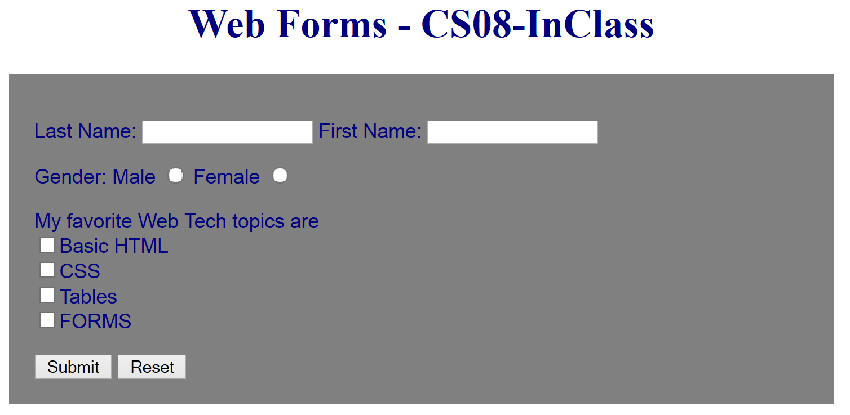
CS08-Inclass.htm
Use the template (today’s template is available under today’s class folder)
Create a form that looks like what is shown here.
MIS3690 Web Technologies Fall 2015
10/13/15
<number>

Slide 16
More Form Tags for User Input
<select> – Allow users to select from a menu
<textarea> – Let user enter multi-line text with optional wrapping
<button> – Let users select an action
MIS3690 Web Technologies Fall 2015
10/13/15
<number>

Slide 17
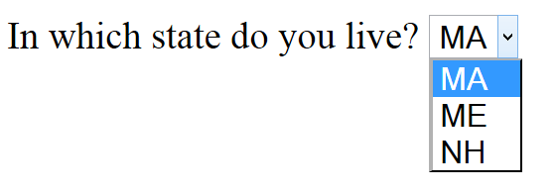
The Select Tag (With Option Tags)
Example:
<p>In which state do you live?
<select name="state">
<option value="MA">MA</option>
<option value="ME">ME</option>
<option value="NH">NH</option>
</select></p>
Optional attribute for select: multiple="multiple"
Optional attribute for select: size="#" – to set number of choices visible
Optional attribute for option: selected="selected"
MIS3690 Web Technologies Fall 2015
10/13/15
<number>

Slide 18
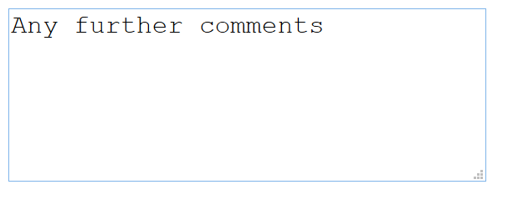
Text Area
Example:
<textarea name="comments" rows="5" cols="29">Any further comments</textarea>
MIS3690 Web Technologies Fall 2015
10/13/15
<number>

Slide 19

Image Buttons
Example:
<button type="submit" name="submit" value="submit">
SUBMIT <img src="mailbox.png" height="30" alt="submit_button" />
</button>
MIS3690 Web Technologies Fall 2015
10/13/15
<number>

Slide 20
CS08-InClass.htm (cont.)
Add a drop-down menu.
Add a text area for comments.
Check it out. Then style it as follows:
For the form:
Set the margins as 50px top and bottom; 100px left and right; set the padding as 20px top and bottom; 50px right and 100px left;
Set the font to Arial, color to Navy
Set background to Silver
For the heading, center it, use Lucida Bright font in Navy color
MIS3690 Web Technologies Fall 2015
10/13/15
<number>

Slide 21
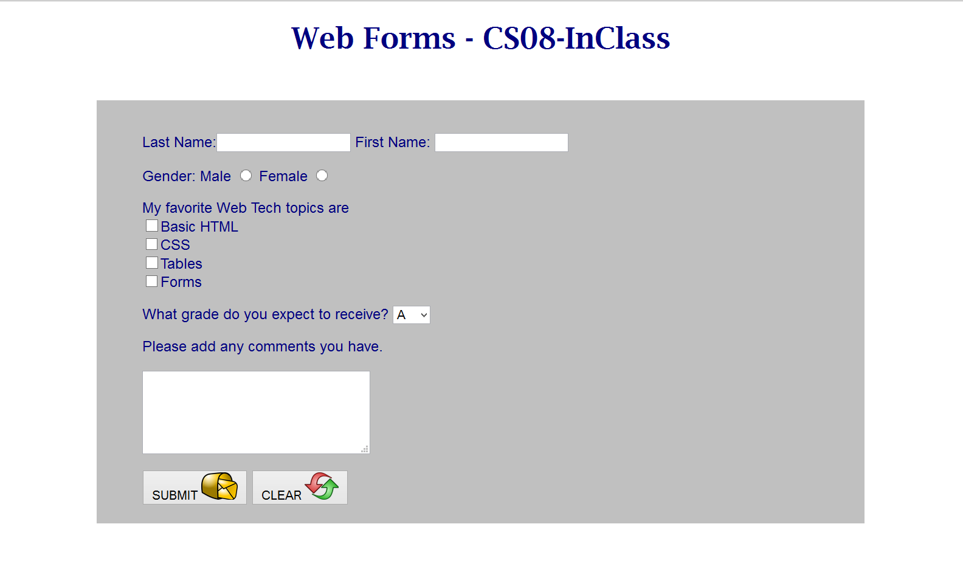
CS08-InClass.htm (cont.)
MIS3690 Web Technologies Fall 2015
10/13/15
<number>

Slide 22
Form Processing
Determined by "action" attribute of the form tag
May be
mailto:address
Works only if user has a mail program, such as Outlook, installed; does not work with webmail
Name of program file on server
Program processes the data submitted by form
MIS3690 Web Technologies Fall 2015
10/13/15
<number>

Slide 23
Encoding Type
Tells browser how to format data when method is post
Example:
enctype="value"
Use for value:
text/plain for mailto
multipart/form-data if form uploads files
application/x-www-form-urlencoded for most other form applications
MIS3690 Web Technologies Fall 2015
10/13/15
<number>

Slide 24
Server Side Processing
When you submit, a server-side program takes over.
Perl or CGI Scripts
ASP or DOT-NET Scripts
Java Servlets
Server-side JavaScript
Complex form processing requires programming
MIS3690 Web Technologies Fall 2015
10/13/15
<number>

Slide 25
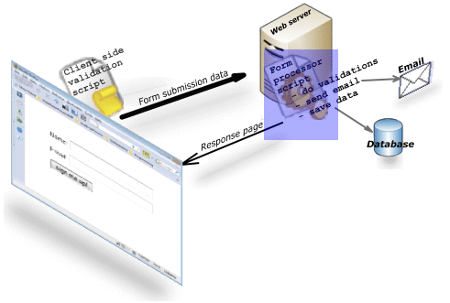
Processing….
Source: http://www.javascript-coder.com/html-form/html-form-tutorial-p4.phtml
MIS3690 Web Technologies Fall 2015
10/13/15
<number>

Slide 26
Processing without a Back-End
Can use the mailto as part of the form action
<form method="post" action=mailto:zli@babson.edu enctype="text/plain">
Sends the content of the form fields to an email address
MIS3690 Web Technologies Fall 2015
10/13/15
<number>

Slide 27
Using A Back-End Hosting Service
There are many services on the Web that will help you send and process your data.
Some are free, others charge.
Most hosting services send you data via email.
Using "mailer.php" on your form.
MIS3690 Web Technologies Fall 2015
10/13/15
<number>

Slide 28
CS08-InClass.htm (cont.)
Download the attached mailer.php program (right-click and Save As into your folder).
Use Notepad to modify the fourth line ("$headers = "From: zli@babson.edu";), replacing my address with yours.
Modify the <form> tag of your CS08-InClass.htm file so that the action is "mailer.php" and the enctype attribute is deleted.
FTP both files to the class FTP server.
NOTE: The mailer.php program will not work on your laptop. It works only on a server that has the php language installed.
Modify your low.htm page so that it has a link to your form. Test the form from the low.htm page. Don't forget to update your low.htm page to the class FTP server.
MIS3690 Web Technologies Fall 2015
10/13/15
<number>

